Slide 1
What is Thymeleaf ?
Thymeleaf is a modern server-side Java template engine for both web and standalone environments, capable of processing HTML, XML, Javascript, CSS and even plain text.
The main goal of Thymeleaf is provide an elegant and highly – maintainable way of creating templates.
It’s commonly used to generate HTML views for web applications.
Thymeleaf is the best choice for developing Spring MVC web applications.

Slide 2
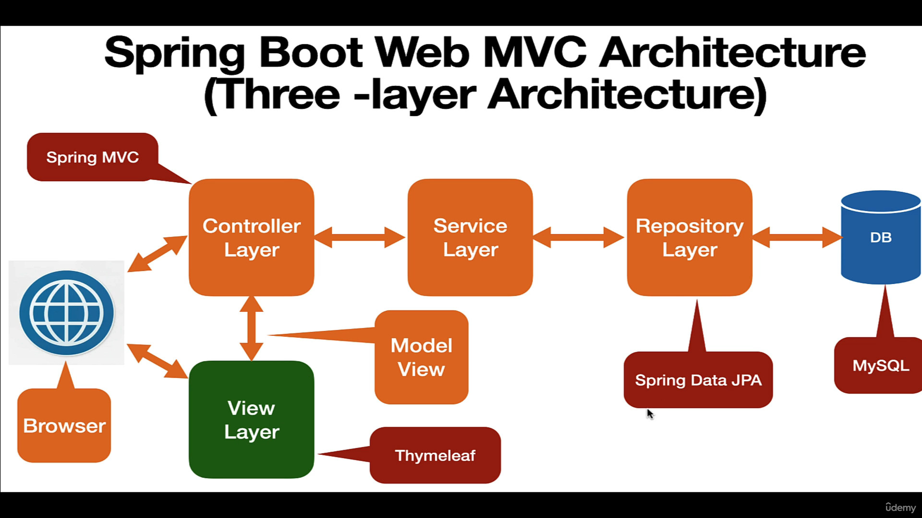

Slide 3
What kind of Thymeleaf can Thymeleaf process?
Out-of-the-box, Thymeleaf allows you to process six kinds of templates:
HTML
XML
Text
Javascript
CSS
RAW (plain text)

Slide 4
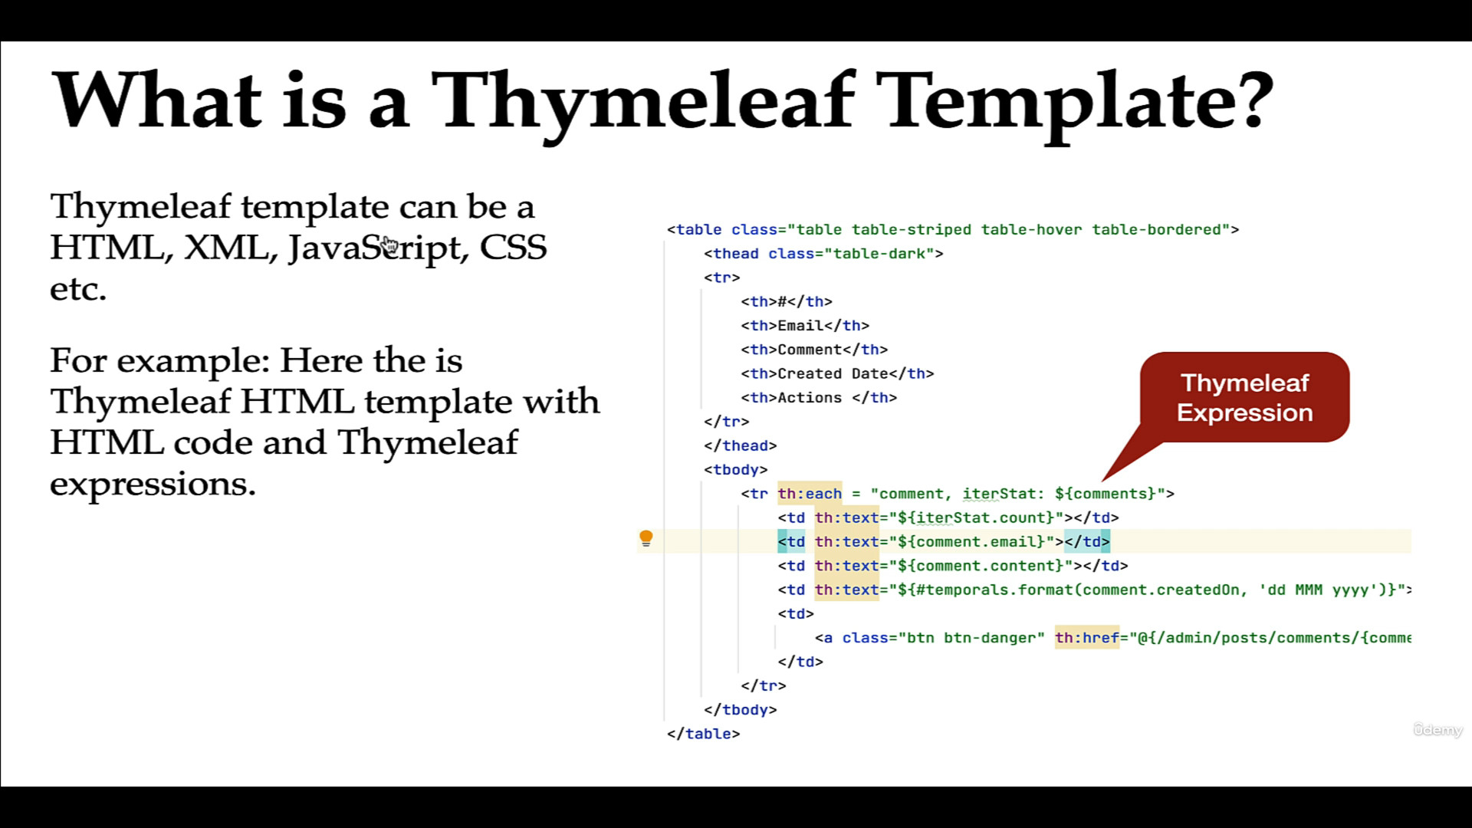

Slide 5
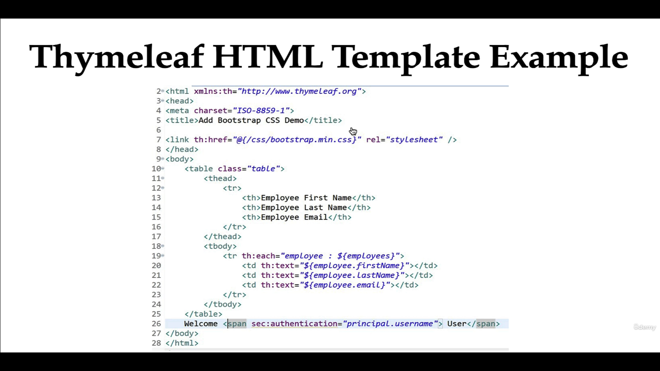

Slide 6
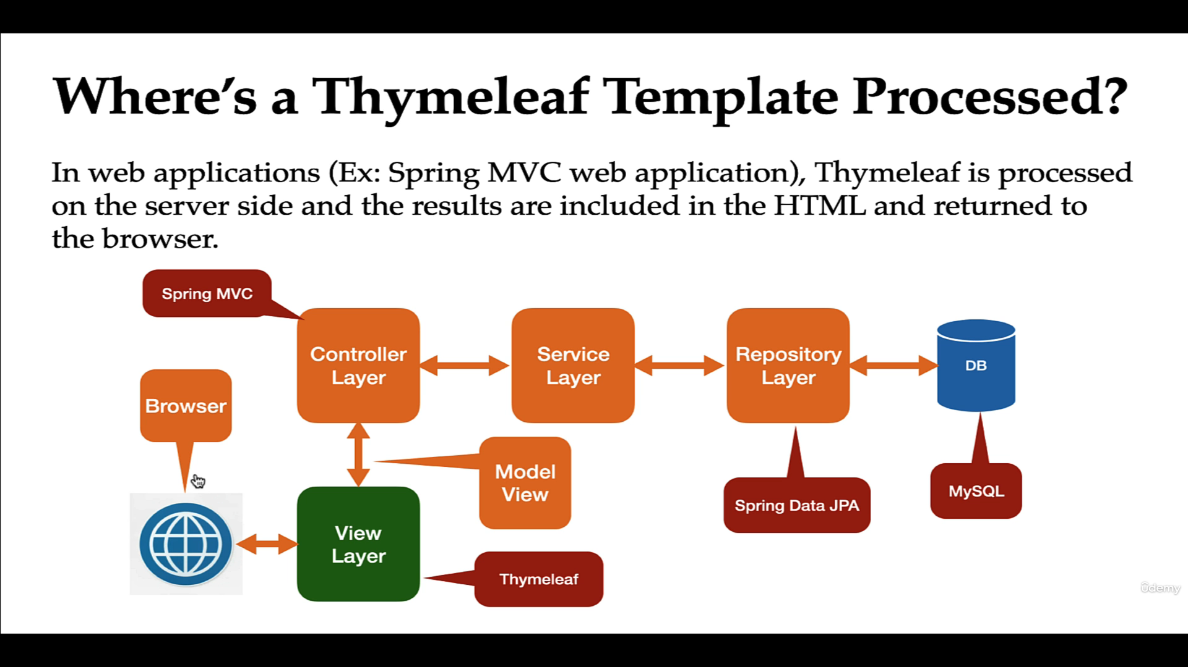

Slide 7
How Thymeleaf Engine works ?

Slide 8
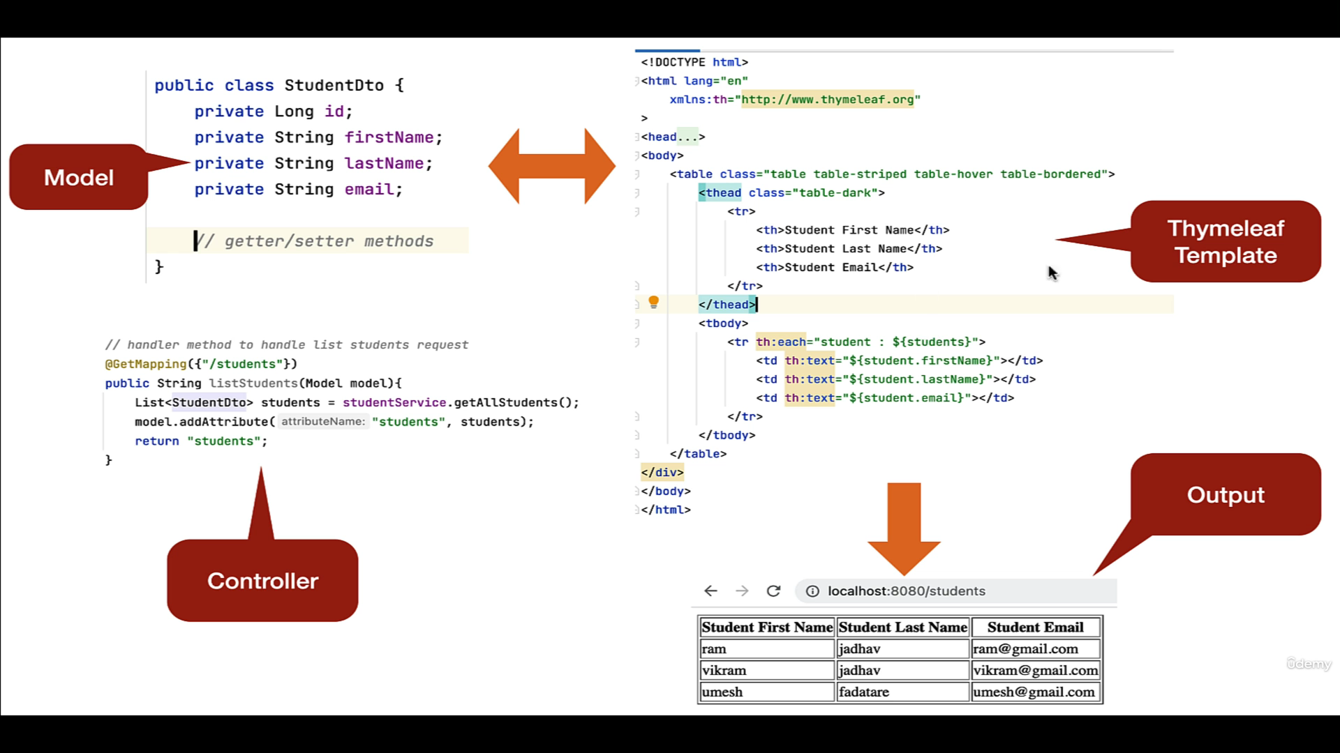

Slide 9
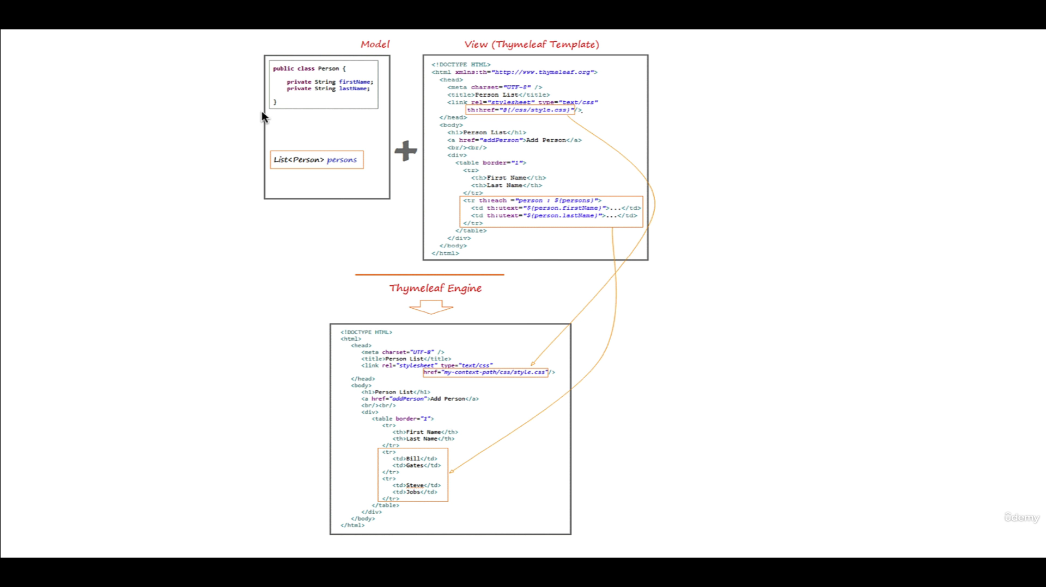
Thymeleaf engine will parse the Thymeleaf template and it uses model data to replace the positions marked on Thymeleaf template to create a new text in the HTMP page.

Slide 10
The spring-boot-start-thymeleaf starter Dependency
Spring boot provides auto-configuration for Thymeleaf by adding the spring-boot-starter-thymeleaf dependency
spring-boot-starter-thymeleaf dependency integrate Thymeleaf with Spring integration dependencies
Spring boot automatically configures view resolver for Thymeleaf
Spring boot auto configure location for Thymeleaf template By default, Spring boot will look Thymeleaf templates in /resources/templates folder

Slide 11
Thymeleaf Standard Expressions
Five type of Thymeleaf standard expressions:
${…}: Variable expressions
*{…}: Selection expressions
#{…}: Message (i18n) expressions
@{…}: Link (URL) expressions
~{…}: Fragment expressions

Slide 12
Variable Expressions
Variable expressions are the most commonly used ones in thymeleaf templates. These expressions help bind the data form the template context(model) into the resulting html(view).
Systax:
${VariableName}

Slide 13
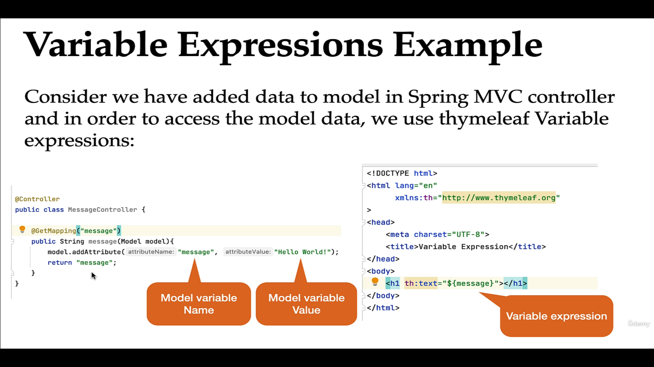

Slide 14
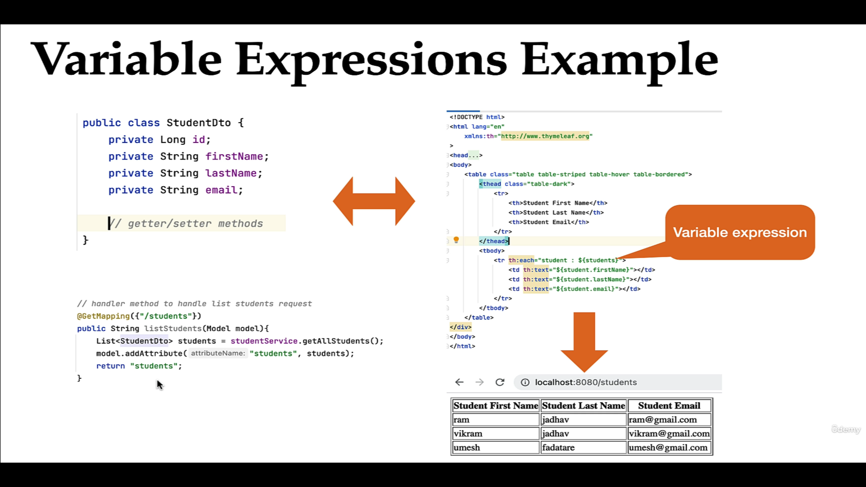

Slide 15
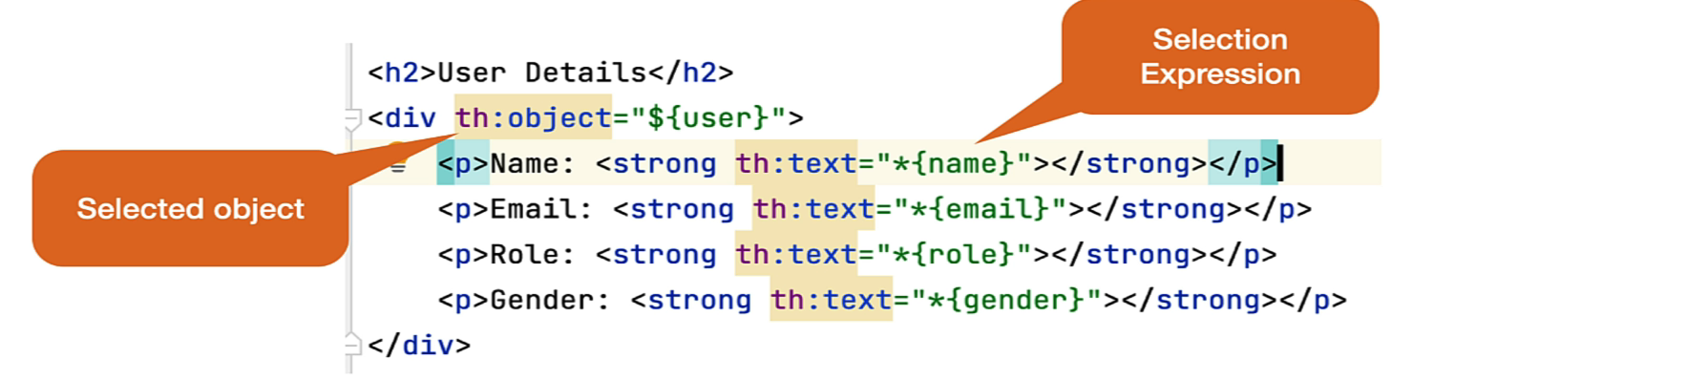
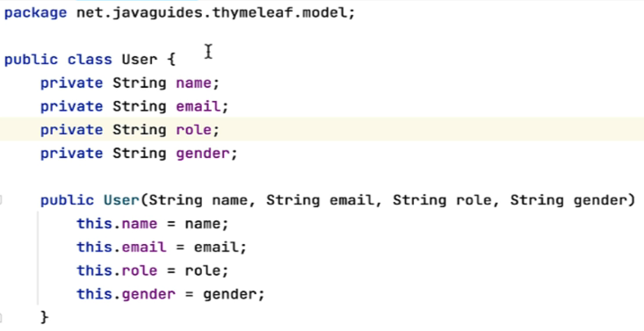
Selection Expressions
Selection expressions are just like variable expressions, except they will be executed on a previously selected object instead of the whole context variable map.
To use selection expressions you first need to define a th:object attribute. After that, You can use the selection expressions to select the attributes/fields of the selected object

Slide 16
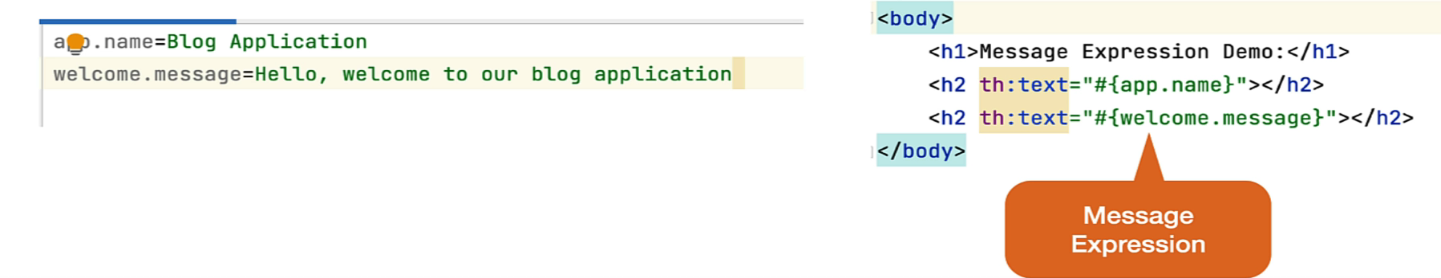
Message Expressions
Message expressions let you externalize common texts into a properties file.
Syntax: #{message.property.key}.
Let’s say you have a welcome message that you want to show on every view. However, hardcoding this message on all of these views is a bad idea.

Slide 17
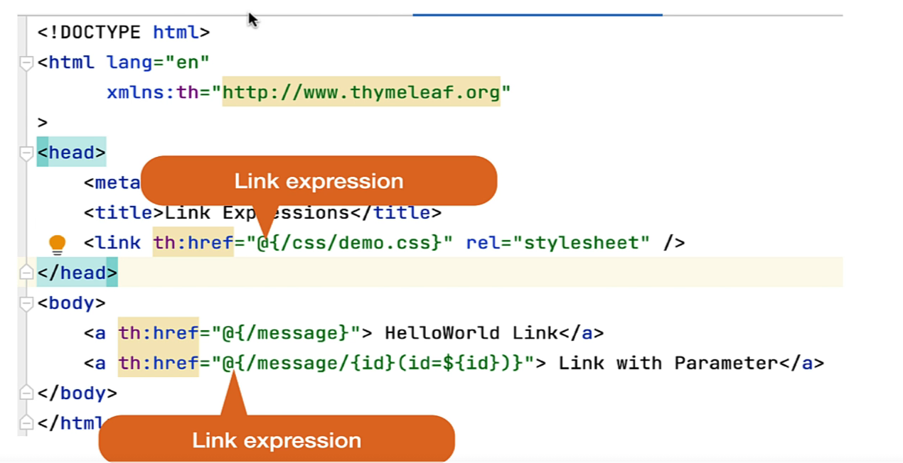
Link Expressions
Link expressions are meant to build URLs in a Thymeleaf templates.
Syntax: @{link}

Slide 18
Fragment Expression
Fragment expressions are an easy way to represent fragments of markup and move them around templates
Syntax: ~{fragment name}
There are three basic ways to include content from a fragment:
th:insert – insert content inside the tag
th:replace – replaces the current tag with the tag defining the fragment
th:include – this is deprecated but it may still appear in a legacy code

Slide 19
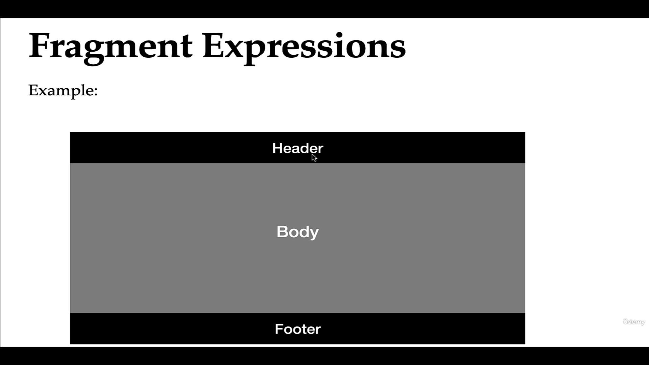

Slide 20
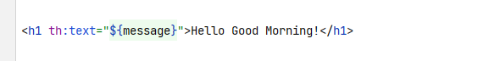
The th:text attribute
This attribute is responsible for displaying text that is evaluated from the expression inside it;
Example: To display a message:
The th:text attribute, which evaluates its value expression and sets the result as the body of the host tag, effectively replacing the “Hello Good Morning!” text we see in the code.

Slide 21
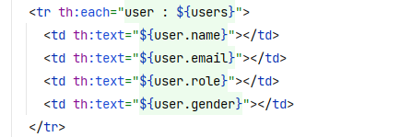
The th:each attribute
In Thymeleaf, iteration or looping is achieved by using the th:each attribute.
One of the interesting things about this attribute is that it will accept and iterate over some different data types, such as: List, Set, Map, Array

Slide 22
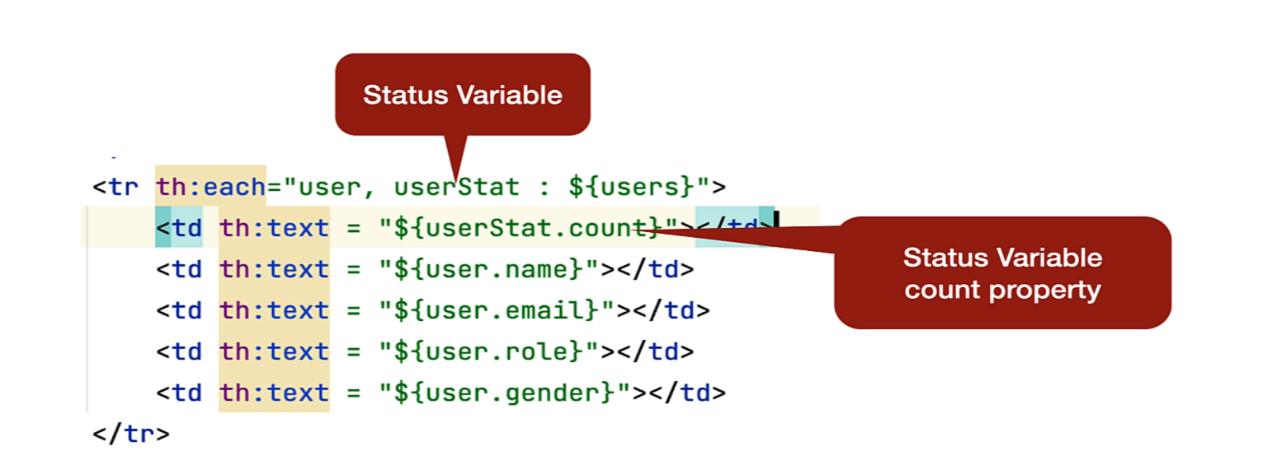
The th:each attribute Status Variable
The Thymeleaf also enables a useful mechanism to keep track of the iteration process via the status variable.

Slide 23
The th:each attribute Status Variable
The status variable provides the following properties:
index: the current iteration index, starting with 0 (zero)
count: the number of elements processed so far
size: the total number of elements in the list
even/odd: checks if the current iteration index is even or odd
first: checks if the current iteration is the first one
last: checks if the current iteration is the last one

Slide 24
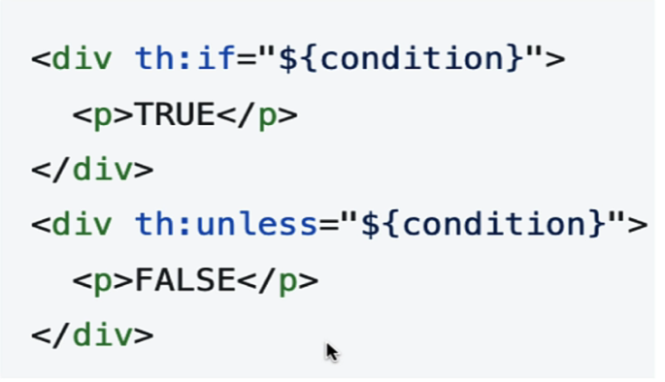
Thymeleaf th:if and th:unless conditions
The th:if and th:unless attributes allow us to render an HTML element depending on a provided condition.
Systax:

Slide 25
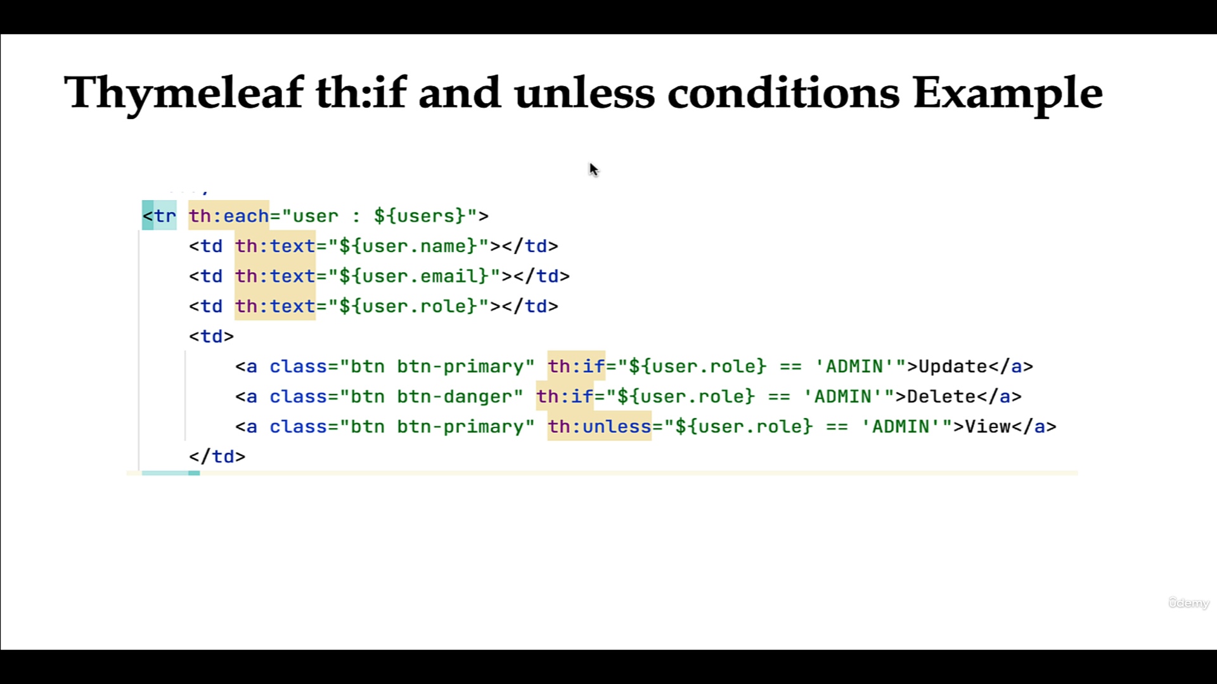

Slide 26
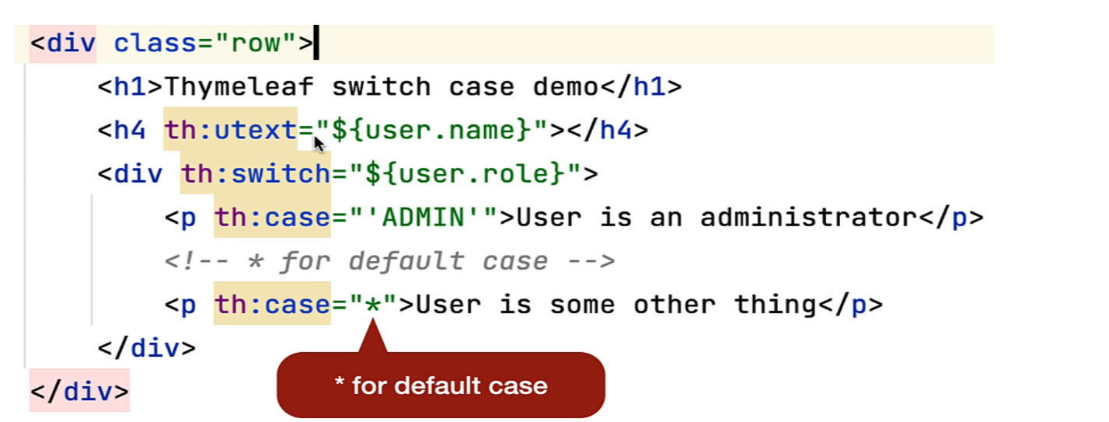
The switch-case condition
If these are more than two possible results of an expression, we can use the th:switch and th:case attributes for the conditional rendering of the HTML elements

Slide 27
Form Handling in Thymeleaf - Attributes
The th:action attribute is used to define action URL for form. This attribute replaces the HTML action attribute of a <form>.
The th:object attribute is used to bind the fields of the form to an model object.
The th:field attribute points to the field name of the model object.

Slide 28
